Slide 1

PROJECT PRESENTATION ON Web-based Credit Card Fraud Detection System using machine Learning Model) By IDOWU OBISANYA C2861872 SUPERVISOR: IOANNIS SFYRAKIS (COURSE CODE: CIS4055-N-FJ1-2024) SCHOOL OF COMPUTING ,ENGINEERING AND DIGITAL TECHNOLOGIES MAY, 2024

Slide 2

Agenda
Introduction
Existing solutions
Methodology, System architecture and steps involved
Evaluation and Results
Conclusion

Slide 3

Will this trend continue?
INTRODUCTION
-Fast adoption of digital payment system, led to increase in credit card fraud.
- According to FTC ,2025 “total consumer losses to fraud in year 2024 was $12.4b in US (25% rise compared to year 2023)”
* total consumer complaint in 2018 was $1.48b(38% increase vs 2017)
Identity theft ranked highest
* Identity theft relating to credit card fraud increased by 24% compared to 2017 (FTC,2019)
What is Fraud?
Act of deception for a gain (ACFE,2025).
crime of cheating someone to get money or goods illegally (OxfordLearnersDictionary.com, 2025)
Why do people commit it?
Figure 1: Fraud Triangle (Association of Certified Fraud Examiner (ACFE), 2025 )

Slide 4
Research Question
Can we develop a system that can allow multiple users to detect fraudulent credit card transactions with high degree of accuracy?
Hypothesis
Implementing a machine learning-based fraud detection system within a web-based platform will greatly enhance user accessibility, promptness and accuracy of the decision-making by the stakeholders compared to a traditional rule-based system.
Objectives of the project
1. To investigate previous research on machine-learning model
To analyze, design and implement various machine-learning models for credit card fraud detection.
To critically evaluate various machine learning models and choose the best: (evaluation metrics)
To deploy the most suitable machine-learning model

Slide 5
EXISTING solutions
CITATIONS | CONTRIBUTIONS | LIMITATIONS
(Pooja, et al., 2021) | Various machine learning models were considered. Neural Network(NN) produced the highest precision and performance with TP of 93.9% and FP less than 6.10% | ** Result was limited to certain features and dataset ** NN was too expensive to train due to resource utilization. ** FP was significant
(Eric, et al., 2024) | Logistic regression and K-Nearest neighbour have accuracy score of 54.86% and 97.69% respectively. Naïve Bayes has 97.92% accuracy while, SVM varied up to 80%. Neural Network gave the best accuracy score (98.44%). Credit card fraud (CCF) in the Philippine was considered. | NN could not detect CCF in real-time
(Vadlamudi, 2015) | Contributions of AI and Machine Learning explored | Trust and Responsible AI to be considered.

Slide 6
EXISTING solutions (contd.)
CITATIONS | CONTRIBUTIONS | LIMITATIONS
(Paruchuri, 2017) | Trained large dataset of a bank’s customers behavior. (Maes et al, 2002) used Bayesian network and Neural Network. Bayesian network was faster in detecting fraud. Other algorithms used were Genetic Algorithm, Logistic Regression, Random Forest. LR gave better result (Movva et al, 2012) | More people are loosing credit information due to theft and Trojan (Donepudi, 2014). Hence, security measure to be considered in future.
(Sulaiman, et al., 2022) | Artificial Neural Network (ANN) gave accuracy score of 95%. SVM while using RFC produced accuracy score of 95%, the false positive transactions were reduced. This resulted in sensitivity score of 87%. An accuracy rate of 97.69% was observed for KNN with optimum performance. KNN can work with less memory and less computation power. An hybrid approach, XGBoost was also used. This produced higher efficiency. SVM and NN produce 99.21% accuracy | Although, SVM, when combined with Random Forest gave the highest accuracy score, but, it was time consuming.

Slide 7

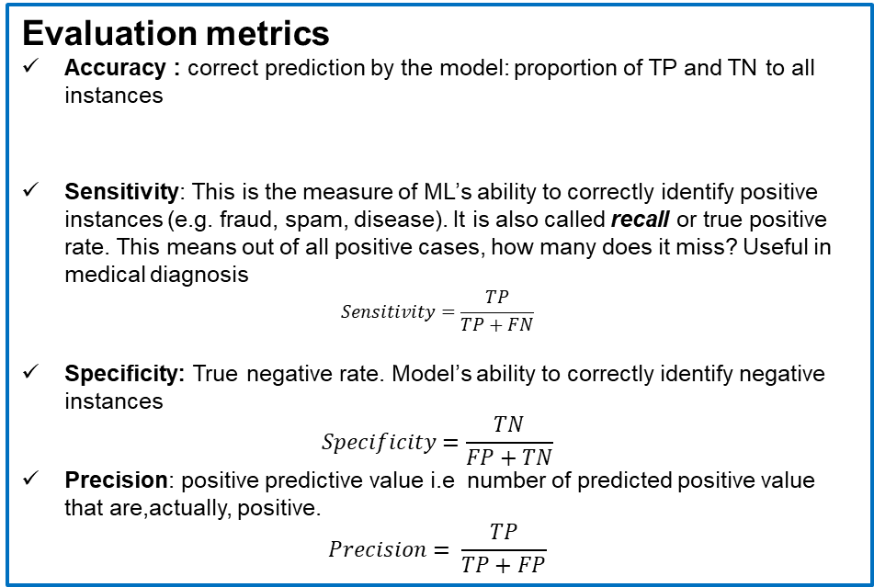
Machine Learning Models & Evaluation metrics
 |  | Actual values
 |  | Positive | Negative
Predicted values | Positive | True Positive (TP) | False Positive (FP) (Type I error)
 | Negative | False Negative (FN) (Type II error) | True Negative (TN)
Machine learning models implemented:
Neural Network model
K-Nearest Neighbour classifier
Logistic Regression (LR) Classifier
XGBoost Model
Random Forest classifier (RFC)
Evaluation metrics
Accuracy : correct prediction by the model: proportion of TP and TN to all instances
Sensitivity: This is the measure of ML’s ability to correctly identify positive instances (e.g. fraud, spam, disease). It is also called recall or true positive rate. This means out of all positive cases, how many does it miss? Useful in medical diagnosis
$$Sensitivity=\frac{TP}{TP+FN}$$
Specificity: True negative rate. Model’s ability to correctly identify negative instances
$$Specificity=\frac{TN}{FP+TN}$$
Precision: positive predictive value i.e number of predicted positive value that are,actually, positive.
$$Precision= \frac{TP}{TP+FP}$$
$$Accuracy=\frac{TP+TN}{TP+FP+TN+FN}$$

Slide 8
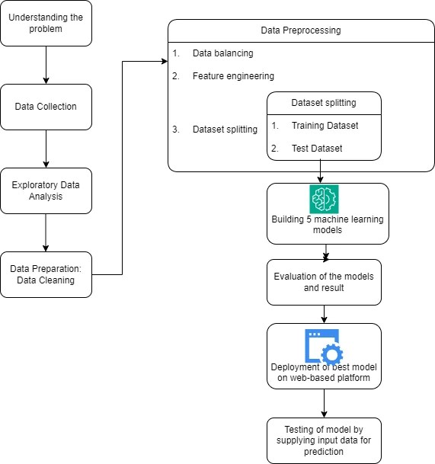
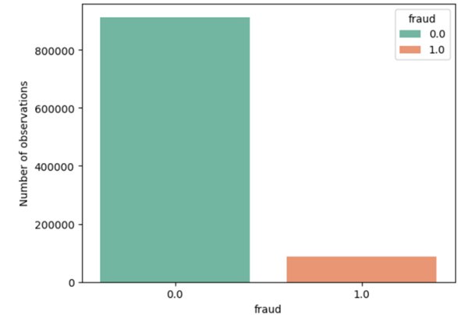
Steps involved
NOTE:
The dataset used for this research work was obtained from Kaggle website through this link: here (Narayanan, 2022)

Slide 9
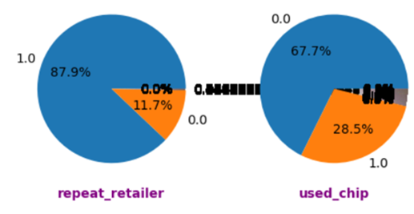
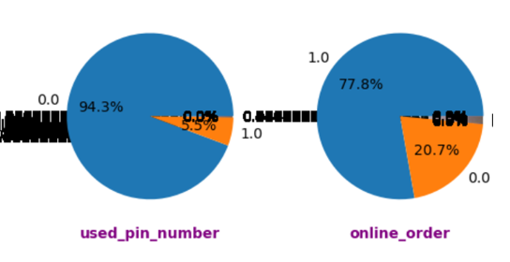
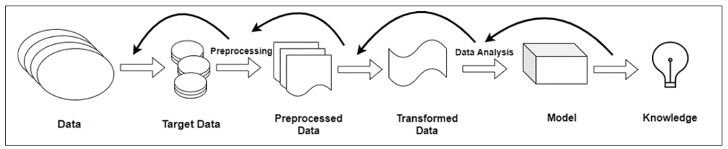
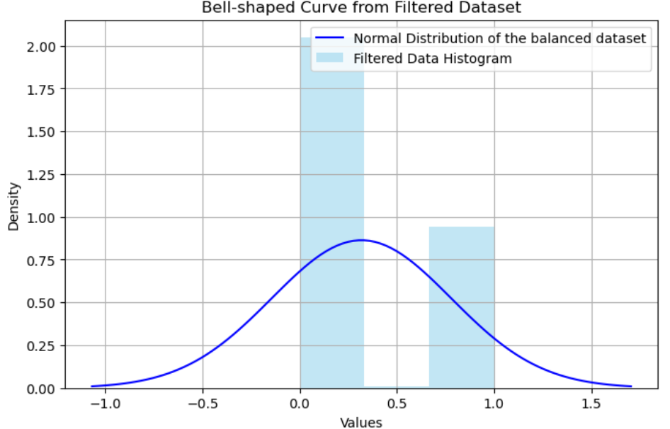
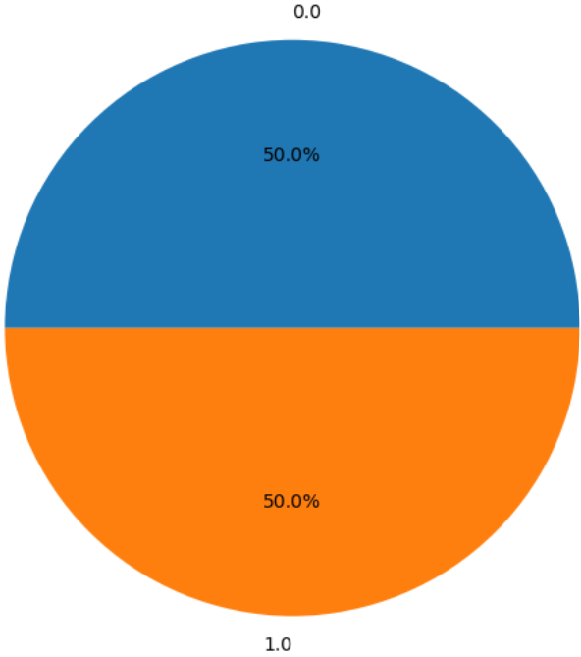
Tasks Performed on the Dataset
Loading the dataset
Exploratory Data Analysis
Data Preprocessing: balancing the dataset using SMOTE (Synthetic Minority Over Sampling Technique)
Modelling
Evaluation of the models
Creating and loading Pickle File
Web Deployment (HTML,CSS)
Testing using test dataset (200,000 records)

Slide 10
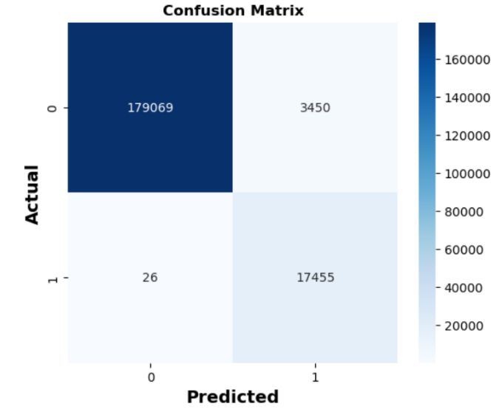
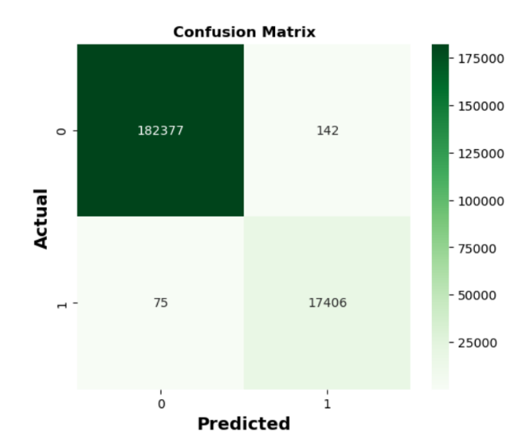
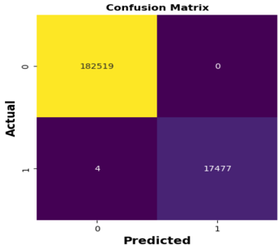
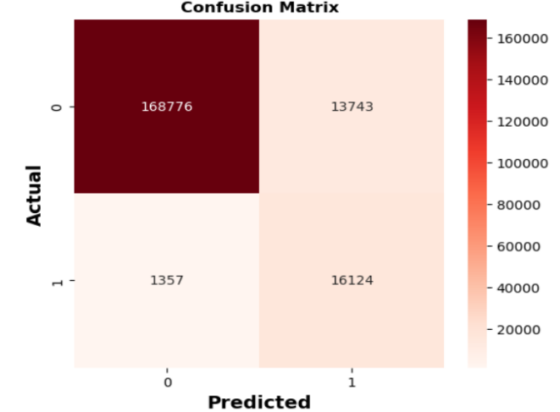
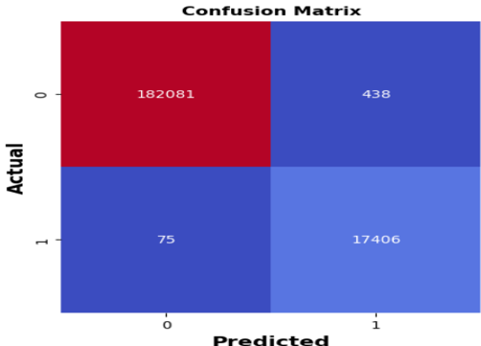
Evaluation and results
 | Machine Learning models | Hyperparameter tuning (GridsearchCV) |  |  |  |  | Original result without hyperparameter tuning |  |  |  |  |  |  | comments
 |  | Accuracy score |  | f1 score | Time | Memory usage (MB) | Accuracy score |  | precision | recall | f1 score | Time | Memory usage
 |  | Training dataset | Test dataset |  | (seconds) | (MB) | Training dataset | Test dataset |  |  |  | (seconds) | (MB)
1 | Random Forest classifier | 0.999969 | 0.999975 | 1.00 | 72,484.29 | 146.89 | 1.000000 | 0.999980 | 1.00 | 1.00 | 1 | 1023.73 | 146.57 | 1. It has the best accuracy score 2. Memory utilization was higher than XGBoost, Logistic Regression and KNN. 3. execution time was second highest, due to several decision trees
2 | K Nearest Neighbour classifier | 0.999340 | 0.998790 | 1.00 | 11,961.97 | 52.07 | 0.999729 | 0.998915 | 1.00 | 1.00 | 1 | 22.31 | 140.86 | 1. It has the second best accuracy score. 2. it has the third highest memory usage 3. execution time was the least of the 5 models
3 | XGboost | 0.998686 | 0.997750 | 0.99 | 119,739.82 | 57.69 | 0.999052 | 0.997435 |  |  | 0.99 | 31.50 | 14.08 | 1. it has the 3rd best accuracy score. 2. It has the lowest memory utilization 3. execution time was short (~31.50 seconds)
4 | Neural Network |  |  |  |  |  | 0.9905 | 0.9826 | 0.92 | 0.99 | 0.95 | 5450.04 | 485.86 | 1. it has the second lowest accuracy score 2. it has the highest memory utilization 3. it is the slowest to execute (highest time)
5 | Logistic Regression | 0.9421 | 0.9352 |  | 4,663.56 | 10.80 | 0.924685 | 0.9245 | 0.77 | 0.92 | 0.82 | 32.80 | 123.98 | 1. This is the worst performing model out of the 5. 2. Its memory utilization was second lowest out of the 5. 3. it took the 3rd greatest amount of time to execute
Neural Network Model
K-Nearest Neighbour
Logistic Regression
XGBoost Model
Random Forest

Slide 11
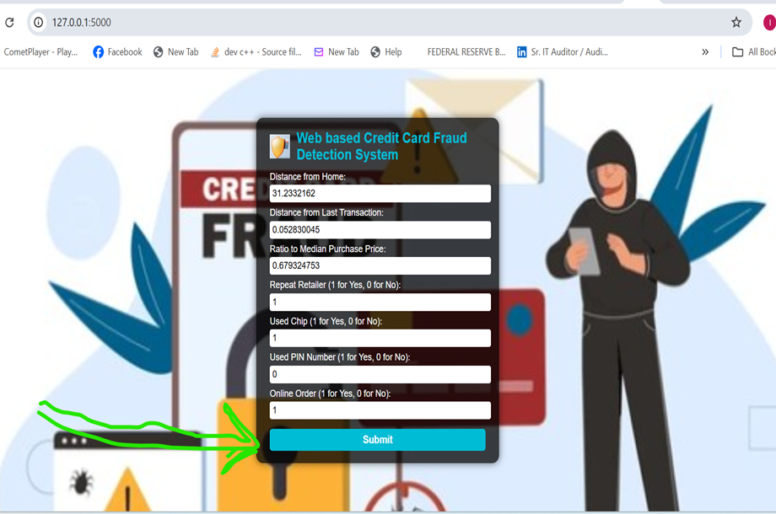
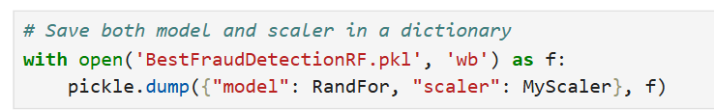
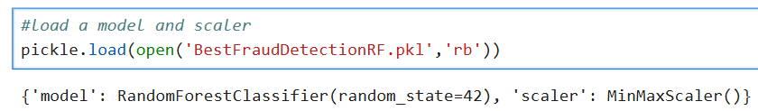
Implementation of the web-based system
Creating a pickle File
Loading the pickle file for new input data
Creating the web application
Python code is linked with web application using flask for requests such as POST,GET, etc.
11

Slide 12

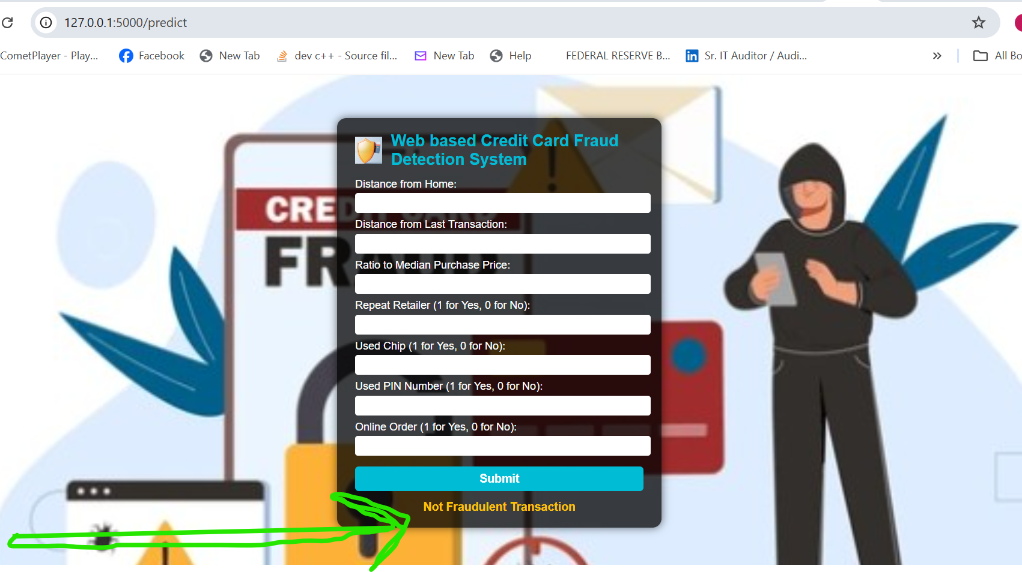
User Interface
Input web page
Output web page

Slide 13
conclusion
This projects proves the effectiveness of Machine Learning (ML) in detecting credit card Fraud
Web-based solution improves accessibility, ease of use and readability of the ML model
Random Forest classifier identified as the best ML model, accuracy score of 99.998% (No False Positive, least False Negative)
Logistic Regression classifier has lowest accuracy score (92.469%) and improved through hyper parameter tuning to 94.21%
If memory space is the most important factor, XgBoost model may be adopted with least memory space (14MB) and accuracy score of 99.9052%
Fastest model is K-Nearest neighbor 22.31 seconds and accuracy score of 99.973%

Slide 14
THANK YOU

